Slide 1



安全 准确 快速 便捷
SF cost optimization
- By Group Unicorn

Slide 2
01
Introduction
02
Clustering
CONTENTS
03
Optimization
04
Cost comparison
05
Further discussion

Slide 3

①
Introduction
Problem description & Data

Slide 4
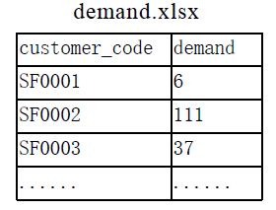
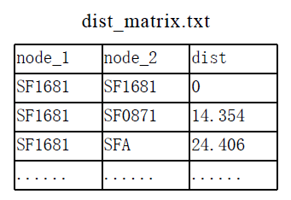
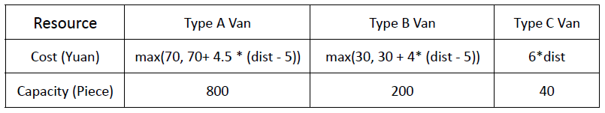
Problem description & Data
Problem description:
Intra-city pickup process
2021 customer areas(potential local hubs) & 1 gateway hub(SFA)
Work out a proper local hub plan, which minimizes the total cost and satisfies customer demands.
Data:
Customer demand
Distance matrix
Parameter:
Vehicle cost and capacity
Fix cost of local hub(￥20)

Slide 5
②
Clustering
Reason for clustering
Clustering model
Clustering algorithm - PAM
Clustering result

Slide 6
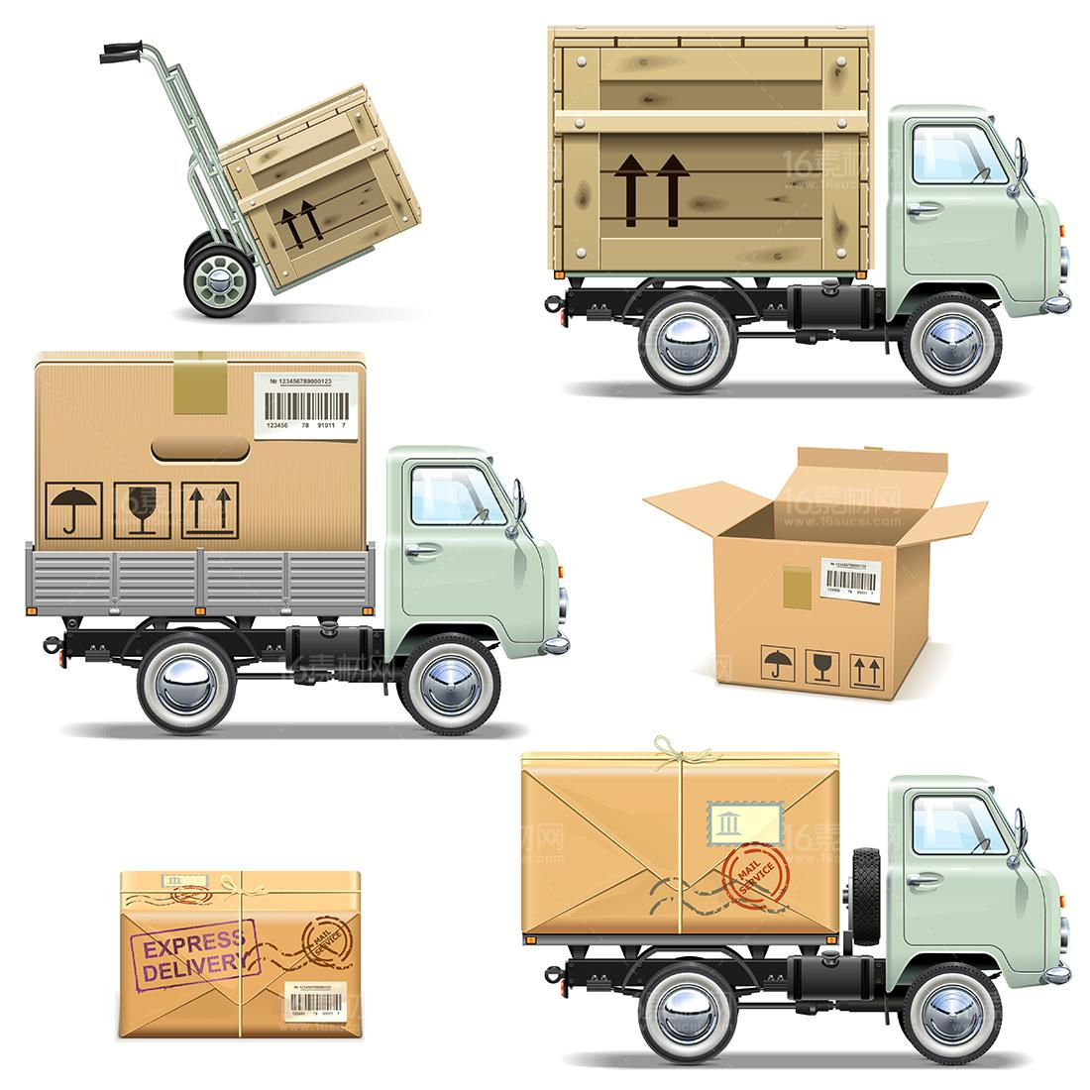
Clustering reason & model
Reasons for clustering
2021 customer nodes：
if we directly do the optimization : NP problem
It takes long time to solve the algorithm
Clustering model
20 clusters with approximately 100 customer nodes in each cluster (80-120 customer nodes are appropriate for the algorithm to solve according to the research)

Slide 7




Clustering algorithm
PAM clustering
We choose PAM clustering algorithm because we only have relative distance between nodes
PAM stands for “partition around medoids”
Clustering rule：
partitional (breaking the dataset up into groups)
attempt to minimize the distance between points labeled to be in a cluster and a point designated as the center of that cluster
1st : transferred the distance matrix into a symmetric matrix
Clustering methods:
PAM clustering
K-means clustering
Hierarchical clustering
2nd: entered the symmetric matrix and got 20 clusters using PAM clustering algorithm

Slide 8

Clustering result
clusters | number_nodes
1 | 231
2 | 103
3 | 90
4 | 85
5 | 66
6 | 134
7 | 58
8 | 79
9 | 78
10 | 104
11 | 76
12 | 120
13 | 48
14 | 93
15 | 103
16 | 160
17 | 132
18 | 68
19 | 109
20 | 84
We got 20 clusters with 60-200 customer nodes in it
Each cluster has customer nodes with smallest possible distance in it - rare extreme case

Slide 9
③
Optimization
Input data
Constraints
Cost Decompositon
Used Tool
Python-Gurobi

Slide 10
Input Data & Decision Variables
N
Xij
1.
List of nodes
A.
Xij = 1
{if node i is assigned to node j}
Dij
yj
2.
Distance between node i and hub j
B.
yj = 1
{if node j is a local hub}
gj
Ci
3.
Distance between hub j and gateway hub SFA
C.
Number of Type C Vancs needed for Node i
di
Aj
4.
Customer demand of node i
D.
Number of Type A Vans needed of Hub j

Slide 11
Constraints
Node i will only be assigned to node j if j is a local hub.
Each node is only assigned to one local hub.
𝑥𝑖𝑗 <= 𝑦𝑗 for all 𝑖,𝑗 ∈ 𝑁
∑𝑥𝑖𝑗 = 1 for each node 𝑖 ∈ 𝑁
Number of vehicles can fulfill the demand
40𝐶𝑖 >= 𝑑𝑖 for each node 𝑖 ∈ 𝑁
800𝐴𝑗 >= ∑ 𝑥𝑖𝑗 ⋅ 𝑑𝑖 for each hub 𝑗 ∈ 𝑁

Slide 12
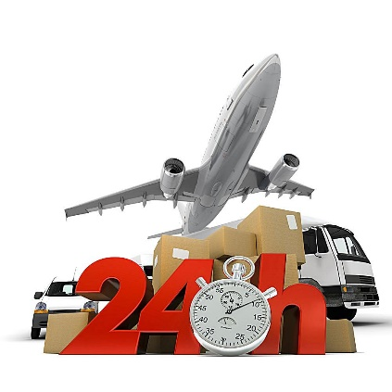
Cost Decomposition
Unit cost: 20
𝐹 ⋅ ∑𝑦𝑗, 𝐹 = 20
Fixed
Cost
Unit cost: 6*dist
∑𝑥𝑖𝑗 ⋅ 6𝐷𝑖𝑗 ⋅ 𝐶𝑖
Cost of Type C Vans
Unit cost: max{70, 70+4.5*(dist-5)}
∑𝑦𝑗 ⋅ 𝑚𝑎𝑥(70, 70+4.5(𝑔𝑗−5)) ⋅ 𝐴𝑗
𝑔′𝑗 = 𝑚𝑎𝑥(5, 𝑔𝑗)
∑𝑦𝑗 ⋅ (70+4.5(𝑔′𝑗−5)) ⋅ 𝐴𝑗
Cost of
Type A Vans
Objective Function: minimize 20𝐹 ⋅ ∑𝑦𝑗 + ∑𝑥𝑖𝑗 ⋅ 6𝐷𝑖𝑗 ⋅ 𝐶𝑖 + ∑𝑦𝑗 ⋅ (70+4.5(𝑔′𝑗−5)) ⋅ 𝐴𝑗
延时符

Slide 13
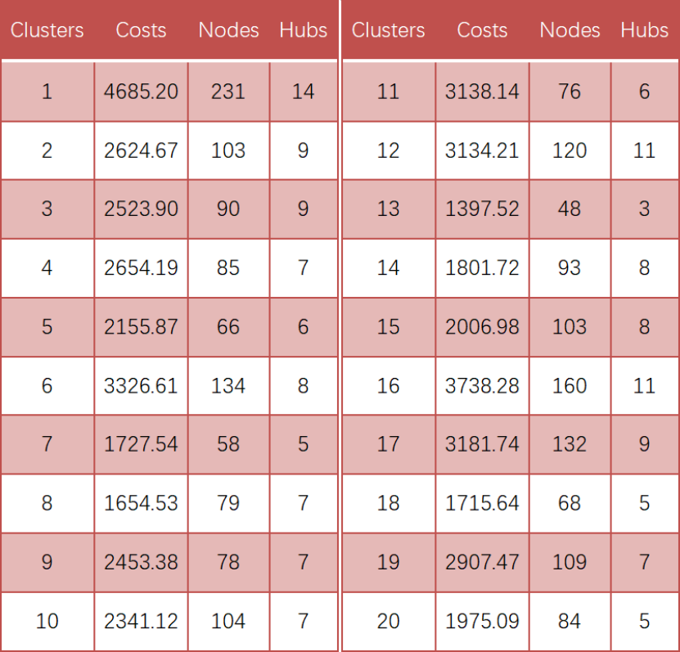


Optimization Result
Average Nodes: 101.05
Average Hubs: 7.6
Average Costs: 2557.19

Slide 14
④
Cost comparison
Cost without local hubs
Cost with local hubs

Slide 15
Cost comparision
With out clustering:
Direct transportation from customer areas to SFA
No fix cost
Only type C van is used
method | fixed cost | Transportation cost - Type A | Transportation cost - Type C | total cost
direct | 0 | 0 | 676308.98 | 676308.98
cluster | 3040 | 26852.38 | 21251.42 | 51143.8
2-node-path | 3040 | 26852.38 | 19222.3 | 49114.68

Slide 16
⑤
Further discussion
Visulization
The variables
About the ‘key’

Slide 17

Further discussion
01
02
03
Visualization
The variables
About the ‘key’
How to show our research result in a more professional way？
e.g. Try to use ArcGIS?
Besides
weight & distance…
More things to consider?
A conclusion for
MORE and FURTHER
use...
More things to consider…
&
Something to improve...

Slide 18
安全 准确 快速 便捷
Thank you!
Worked by: Group Unicorn

